Slide 1
Netflix
Viramya Shah

Slide 2
Assignment 1
Build ontology diagram for the given Netflix dataset

Slide 3
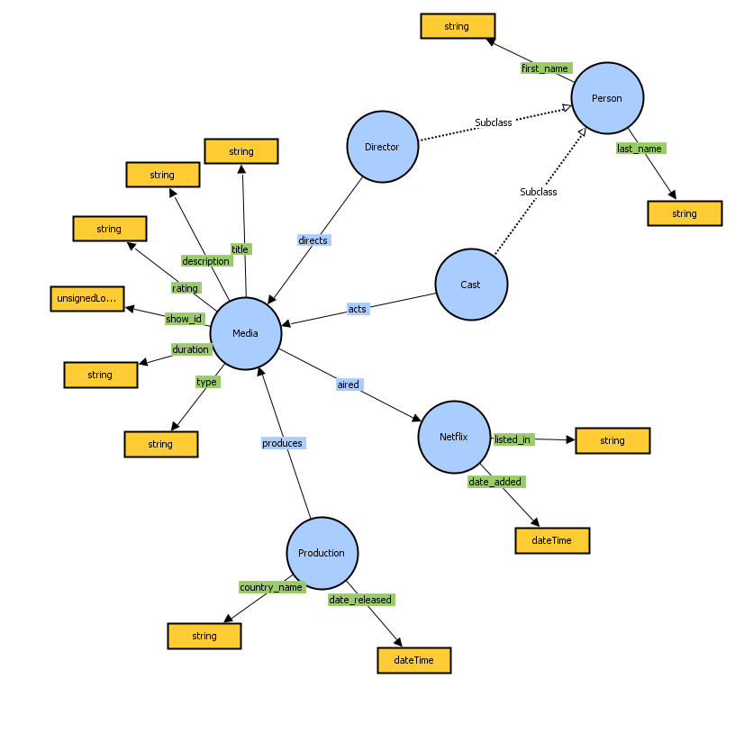
Ontology Diagram
The dataset is broken down into semantic-based classes.
For example,
Director and Cast were clubbed under Person
Country_name and release_year came under Production and so on

Slide 4
Assignment 2
Cluster movies together and use those labels to make a classification model
I am using cluster labels along with other features to predict the genre

Slide 5
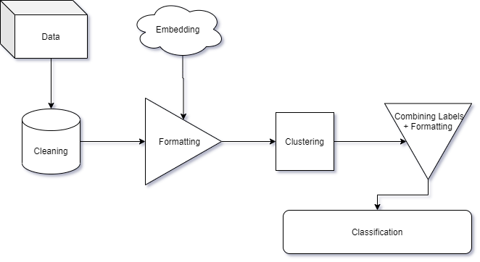
Process
Data Cleaning
Formatting and text embedding
Clustering
Re-formatting
Classification

Slide 6
Data Cleaning and Formatting
Cleaning | Reformating | Encoding
Date | Director | Rating
Country | Cast
Release Year | Duration
Description
Cleaning: Removing non-ascii character, space trimming, and imputing NaNs
Reformating: Structuring the column values
Rating: Categorical encoding
File: clean_data.csv

Slide 7
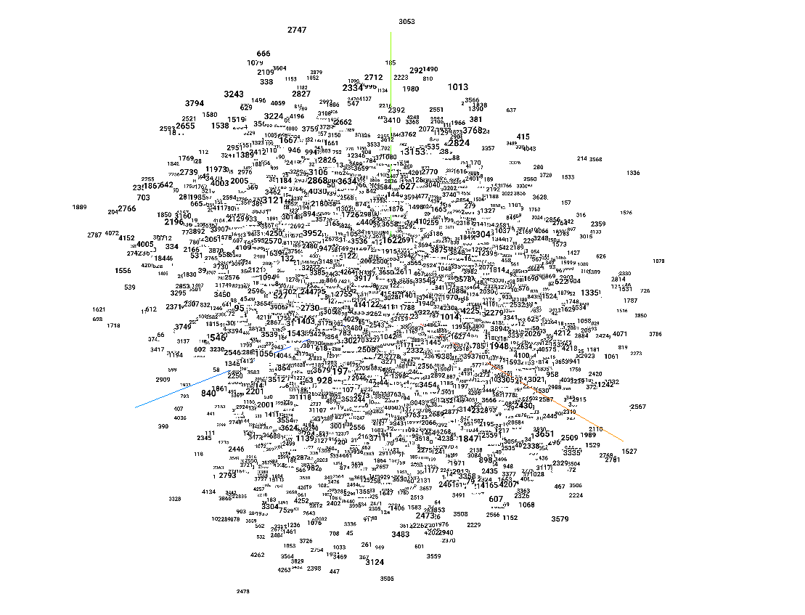
Embedding
Used Flair package to get state-of-the-art embeddings
Stacked the following embeddings using RNN together to form a 128-d vector
Glove
News-forward (flair-specific)
News-backward (flair-specific)
The models are trained with 1B word corpus
Files to check: embedding.tsv

Slide 8
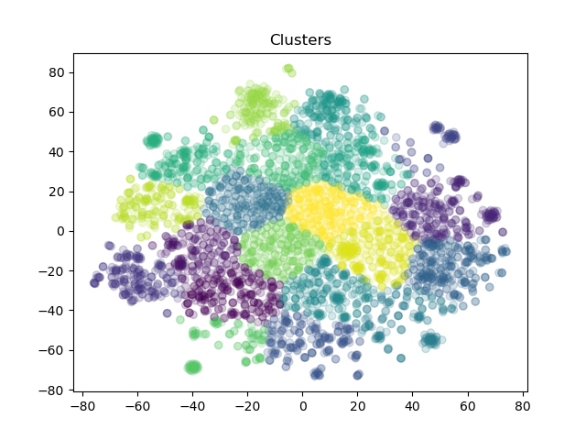
Clustering
Used tSNE to decompose the 128-d embedding.
Used KMeans to cluster the embedding vector into 20 clusters
File to check: post_cluster.csv

Slide 9
Feature Engineering and Formatting
New features added
Director_factor, cast_factor, num_of_director, num_of_cast
Formatting
One-hot-encoding the label column i.e. listed_in in my case
This makes the label of size (X, 20)
Splitting dataset into 80-20 train-test splits

Slide 10
Classification and Metrics
Used 3-fold cross validation along with GridSearch for fine-tuning hyperparameters for following models:
Random Forest
K Nearest Neighbor
Multi Layer Perceptron
Extra Tree Classifier
All the models are based in sklearn.
File to check: final_result.csv
Used following metrics to compare the 20-d label vector
Euclidean Distance
Idea is to check how far the prediction and truth vectors are
Manhattan Distance
Same idea as Euclidean distance
Intersection Score
The idea is to check how many correct genre predictions are done

Slide 11
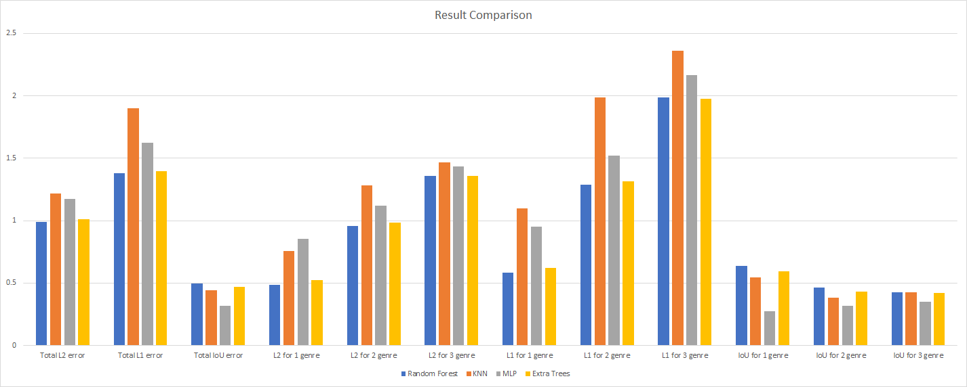
How to infer?
Sample: L2 for 2 genre means total euclidean distance for only 2-genre test labels. Similarly, IoU for 1 genre means total intersection only for test labels with 1 genre.
File: final_result.csv

Slide 12
Thank you
Looking forward to talking with you tomorrow

